Slide 1
Integration Testing
SE401: Software Quality Assurance and Testing

Slide 2
Outline
Case Study - Mars Climate Orbiter
Integration Testing
Integration Test Strategies
System, Acceptance, and Regression Testing
Acceptance Testing
System Testing
Regression Testing
Summary

Slide 3
Case Study − Mars Climate Orbiter
Notes:
Click to add notes

Slide 4
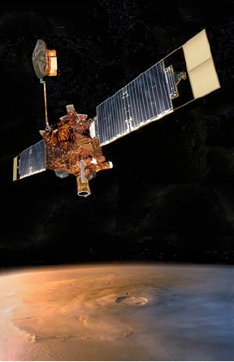
Case Study − Mars Climate Orbiter
NASA’s Mars Climate Orbiter
Launched on December 11, 1998
Intended to enter an orbit at 140 –150 km above Mars.
On September 23, 1999
It smashed into the planet's atmosphere and was destroyed.
Cost: $328M

Slide 5
Case Study − Mars Climate Orbiter
Cause of failure
The software controlling the thrusters on the spacecraft used different units.
Software modules were developed by teams in US and Europe
Engineers failed to convert the measure of rocket thrusts
English unit: Pound-Force
Metric unit: Newton, kg • m / s²
Difference: a factor of ≈ 4.45

Slide 6
Integration Testing
Integration testing (sometimes called integration and testing, abbreviated I&T) is the phase in software testing in which individual software modules are combined and tested as a group. It occurs after unit testing and before validation testing.

Slide 7
Objectives
Understand the purpose of integration testing
Distinguish typical integration faults from faults that should be eliminated in unit testing
Understand the nature of integration faults and how to prevent as well as detect them
Understand strategies for ordering construction and testing
Approaches to incremental assembly and testing to reduce effort and control risk
Notes:
7

Slide 8
Integration vs. Unit Testing
Unit (module) testing is a necessary foundation
Unit level has maximum controllability and visibility
Integration testing can never compensate for inadequate unit testing
Integration testing may serve as a process check
If module faults are revealed in integration testing, they signal inadequate unit testing
If integration faults occur in interfaces between correctly implemented modules, the errors can be traced to module breakdown and interface specifications

Slide 9
Integration Testing
The entire system is viewed as a collection of subsystems (sets of classes) determined during the system and object design
Goal: Test all interfaces between subsystems and the interaction of subsystems
The Integration testing strategy determines the order in which the subsystems are selected for testing and integration.

Slide 10
Why do we do integration testing?
Unit tests only test the unit in isolation
Many failures result from faults in the interaction of subsystems
Often many Off-the-shelf components are used that cannot be unit tested
Without integration testing the system test will be very time consuming
Failures that are not discovered in integration testing will be discovered after the system is deployed and can be very expensive.

Slide 11
Types of Testing
Unit Testing:
Individual subsystem
Carried out by developers (of components)
Goal: Confirm that subsystems is correctly coded and carries out the intended functionality
Integration Testing:
Groups of subsystems (collection of classes) and eventually the entire system
Carried out by developers
Goal: Test the interface and the interplay among the subsystems

Slide 12
Types of Testing
System Testing:
The entire system
Carried out by developers (testers!)
Goal: Determine if the system meets the requirements (functional and global)
Functional Testing: Test of functional requirements
Performance Testing: Test of non-functional requirements
Acceptance and Installation Testing:
Evaluates the system delivered by developers
Carried out by the client.
Goal: Demonstrate that the system meets customer requirements and is ready to use

Slide 13
What is Integration Testing?
 | Unit/module test | Integration test | System test
Specification: | Module interface | Interface specs, module breakdown | Requirements specification
Visible structure: | Coding details | Modular structure (software architecture) | — none —
Scaffolding required: | Some | Often extensive | Some
Looking for faults in: | Modules | Interactions, compatibility | System functionality

Slide 14
Testing Level Assumptions and Objectives
Unit Assumptions | Unit Goals
All other units are correct Compiles correctly | Correct unit function Coverage metrics satisfied
Integration Assumptions | Integration Goals
Unit testing complete | Interfaces correct Correct function across units Fault isolation support
System Assumptions | System Goals
Integration testing complete Tests occur at port boundary | Correct system functions Non-functional requirements tested Customer satisfaction

Slide 15
What is Software Integration Testing?
Testing activities that integrate software components together to form a complete system. To perform a cost-effective software integration, integration test strategy, integration test set are needed.
Integration testing focuses on:
Interfaces between modules (or components)
Integrated functional features
Interacting protocols and messages
System architectures
Who performs software integration:
Developers and test engineers
What do you need?:
Integration strategy
Integration test environment and test suite
Module (or component) specifications
Interface and design documents

Slide 16
Integration Faults
Inconsistent interpretation of parameters or values
Example: Mixed units (Pound/Newton) in Martian Lander
Violations of value domains, capacity, or size limits
Example: Buffer overflow
Side effects on parameters or resources
Example: Conflict on (unspecified) temporary file

Slide 17
Integration Faults
Omitted or misunderstood functionality
Example: Inconsistent interpretation of web requests
Nonfunctional properties
Example: Unanticipated performance issues
Dynamic mismatches
Example: Incompatible polymorphic method calls

Slide 18
Example: A Memory Leak
Apache web server, version 2.0.48
Response to normal page request on secure (https) port
static void ssl_io_filter_disable(ap filter t *f) {
bio_filter_in_ctx_t *inctx = f->ctx;
inctx->ssl = NULL;
inctx->filter_ctx->pssl = NULL;
}
No obvious error, but Apache leaked memory slowly (in normal use) or quickly (if exploited for a DOS attack)

Slide 19
Example: A Memory Leak
Apache web server, version 2.0.48
Response to normal page request on secure (https) port
static void ssl_io_filter_disable(ap filter t *f) {
bio_filter_in_ctx_t *inctx = f->ctx;
SSL_free(inctx -> ssl);
inctx->ssl = NULL;
inctx->filter_ctx->pssl = NULL;
}
The missing code is for a structure defined and created elsewhere, accessed through an opaque pointer.

Slide 20
Example: A Memory Leak
Apache web server, version 2.0.48
Response to normal page request on secure (https) port
static void ssl_io_filter_disable(ap filter t *f) {
bio_filter_in_ctx_t *inctx = f->ctx;
SSL_free(inctx -> ssl);
inctx->ssl = NULL;
inctx->filter_ctx->pssl = NULL;
}
Almost impossible to find with unit testing. (Inspection and some dynamic techniques could have found it.)

Slide 21
What is a software integration strategy?
Software test strategy provides the basic strategy and guidelines to test engineers to perform software testing activities in a rational way.
Software integration strategy usually refers to
an integration sequence (or order) to integrate different parts (or components) together

Slide 22
Integration Test Strategies

Slide 23
Maybe You’ve Heard ...
Yes, I implemented module A, but I didn’t test it thoroughly yet.
It will be tested along with module B when that’s ready.

Slide 24
Translation ...
Yes, I implemented module A, but I didn’t test it thoroughly yet.
It will be tested along with module B when that’s ready.
I didn’t think at all about the strategy for testing.
I didn’t design module A for testability and I didn’t think about the best order to build and test modules A and B

Slide 25
Integration Plan & Test Plan
Integration test plan drives and is driven by the project “build plan”
A key feature of the system architecture and project plan
System Architecture
...
...
Build Plan
Test Plan
...

Slide 26
Drivers and Stubs
Driver: A program that calls the interface procedures of the module being tested and reports the results
A driver simulates a module that calls the module currently being tested
Stub: A program that has the same interface as a module that is being used by the module being tested, but is simpler.
A stub simulates a module called by the module currently being tested

Slide 27
Drivers and Stubs
Driver
Module
Under Test
Stub
procedure
call
procedure
call
access to global
variables
Driver and Stub should have the same interface as the modules they replace
Driver and Stub should be simpler than the modules they replace

Slide 28
Stubs and drivers
Driver:
A component, that calls the TestedUnit
Controls the test cases
Stub:
A component, the TestedUnit depends on
Partial implementation
Returns fake values.
Driver
Tested
Unit
Stub

Slide 29
Example: A 3-Layer-Design (Spreadsheet)
A
A
Spread SheetView
A
Spread SheetView
Layer I
B
B
C
C
D
D
Entity
Model
Calculator
Currency
Converter
Data Model
B
Calculator
C
Currency
Converter
D
Layer II
E
E
G
F
G
F
BinaryFile Storage
E
BinaryFile Storage
Currency DataBase
G
XMLFile Storage
Currency DataBase
Layer III
F
XMLFile Storage
Notes:
For the following integration testing strategies, we use this call hierarchy of an example design consisting of 3 layers and 7 subsystems.

Slide 30
Approaches to Integration Testing
(“source” of test cases)
Functional Decomposition (most commonly described in the literature)
Top-down
Bottom-up
Sandwich
“Big bang”
Call graph
Pairwise integration
Neighborhood integration

Slide 31
Basis of Integration Testing Strategies
Functional Decomposition applies best to procedural code
Call Graph
applies to both procedural and object-oriented code

Slide 32
Example—Calendar Program
Date in the form mm, dd, yyyy
Calendar functions
the date of the next day (NextDate)
the day of the week corresponding to the date
the zodiac sign of the date
the most recent year in which Memorial Day was celebrated on May 27
the most recent Friday the Thirteenth

Slide 33
Calendar Program Units
Main
Calendar Function isLeap
Procedure weekDay
Procedure getDate
Function isValidDate
Function lastDayOfMonth Procedure getDigits
Procedure memorialDay
Function isMonday Procedure friday13th
Function isFriday
Procedure nextDate
Procedure dayNumToDate Procedure zodiac

Slide 34
Functional Decomposition of Calendar
Calendar (Main)
isLeap
weekDay
getDate
zodiac
nextDate
Friday13th
MemorialDay
isValidDate
getDigits
DaynumToDate
isFriday
isMonday
lastDayOfMonth
dateToDaynum

Slide 35
First Step in Top-Down Integration
Calendar (Main)
isLeap
weekDay
getDate
zodiac
nextDate
Friday13th
MemorialDay
“Grey” units are stubs that return the correct values when referenced.
This level checks the main program logic.

Slide 36
weekDayStub
Procedure weekDayStub(mm, dd, yyyy, dayName) If ((mm = 10) AND (dd = 28) AND (yyyy = 2013))
Then dayName = “Monday”
EndIf
.
.
.
If ((mm = 10) AND (dd = 30) AND (yyyy = 2013))
Then dayName = “Wednesday”
EndIf

Slide 37
Next Three Steps (replace one stub at a time with the actual code.)
Calendar (Main)
isLeap
weekDay
getDate
zodiac
nextDate
Friday13th
MemorialDay
Calendar (Main)
isLeap
weekDay
getDate
zodiac
nextDate
Friday13th
MemorialDay
Calendar (Main)
isLeap
weekDay
getDate
zodiac
nextDate
Friday13th
MemorialDay

Slide 38
Top-Down Integration Mechanism
Breadth-first traversal of the functional decomposition tree.
First step: Check main program logic, with all called units replaced by stubs that always return correct values.
Move down one level
replace one stub at a time with actual code.
any fault must be in the newly integrated unit

Slide 39
Bottom-Up Integration Mechanism
Reverse of top-down integration
Start at leaves of the functional decomposition tree.
Driver units...
call next level unit
serve as a small test bed
“drive” the unit with inputs
drivers know expected outputs
As with top-down integration, one driver unit at a time is replaced with actual code.
Any fault is (most likely) in the newly integrated code.

Slide 40
Top-Down and Bottom-Up Integration
Both depend on throwaway code.
drivers are usually more complex than stubs
Both test just the interface between two units at a time.
In Bottom-Up integration, a driver might simply reuse unit level tests for the “lower” unit.
Fan-in and fan-out in the decomposition tree results in some redundancy.

Slide 41
Starting Point of Bottom-Up Integration
Calendar (Main)
isLeap
weekDay
getDate
zodiac
nextDate
Friday13th
MemorialDay
isValidDate
getDigits
DaynumToDate
isFriday
isMonday
lastDayOfMonth
dateToDaynum

Slide 42
Bottom-Up Integration of Zodiac
Calendar (driver)
isLeap
weekDay
getDate
zodiac
nextDate
Friday13th
MemorialDay

Slide 43
Sandwich Integration
Avoids some of the repetition on both top-down and bottom-up integration.
Nicely understood as a depth-first traversal of the functional decomposition tree.
A “sandwich” is one path from the root to a leaf of the functional decomposition tree.
Avoids stub and driver development.
More complex fault isolation.

Slide 44
A Sample Sandwich
Calendar (Main)
isLeap
weekDay
getDate
zodiac
nextDate
Friday13th
MemorialDay
isValidDate
getDigits
DaynumToDate
isFriday
isMonday
lastDayOfMonth
dateToDaynum

Slide 45
“Big Bang” Integration
Calendar (Main)
isLeap
weekDay
getDate
zodiac
nextDate
Friday13th
MemorialDay
isValidDate
getDigits
DaynumToDate
isFriday
isMonday
lastDayOfMonth
dateToDaynum

Slide 46
“Big Bang” Integration
No...
stubs
drivers
strategy
And very difficult fault isolation
This is the practice in an agile environment with a daily run of the project to that point.

Slide 47
Top-down Approach Vs Bottom-up Approach
Basis for Comparison | Top-down Approach | Bottom-up Approach
Basic | Breaks the massive problem into smaller sub-problems | Solves the fundamental low-level problem and integrates them into a larger one
Process | Submodules are solitarily analyzed | Examine what data is to be encapsulated, and implies the concept of information hiding
Redundancy | Contain redundant information | Redundancy can be eliminated
Programming languages | Structure/procedural oriented programming languages | Object-oriented programming languages
Mainly used in | Module documentation, test case creation, code implementation and debugging | Testing

Slide 48
Pros and Cons of Decomposition-Based Integration
Pros
intuitively clear
“build” with proven components
fault isolation varies with the number of units being integrated
Cons
based on lexicographic inclusion (a purely structural consideration)
some branches in a functional decomposition may not correspond with actual interfaces.
stub and driver development can be extensive

Slide 49
Call Graph-Based Integration
Definition: The Call Graph of a program is a directed graph in which
nodes are unit
edges correspond to actual program calls (or messages)
Call Graph Integration avoids the possibility of impossible edges in decomposition-based integration.
Can still use the notions of stubs and drivers.
Can still traverse the Call Graph in a top-down or bottom-up strategy.

Slide 50
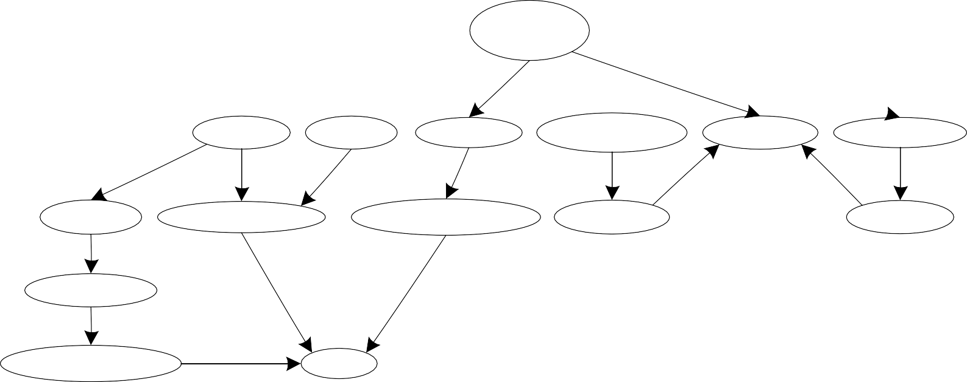
Call Graph of the Calendar Program
Calendar (Main)
getDate
zodiac
nextDate
memorialDay
weekDay
Friday13th
getDigits
dateToDaynum
dayNumToDate
isMonday
isFriday
isValidDate
lastDayOfMonth
isLeap

Slide 51
Call Graph-Based Integration (continued)
Two strategies
Pair-wise integration
Neighborhood integration
Degrees of nodes in the Call Graph indicate integration sessions
isLeap and weekDay are each used by three units
Possible strategies
test high indegree nodes first, or at least,
pay special attention to “popular” nodes

Slide 52
Pair-Wise Integration
By definition, an edge in the Call Graph refers to an interface between the units that are the endpoints of the edge.
Every edge represents a pair of units to test.
Still might need stubs and drivers
Fault isolation is localized to the pair being integrated

Slide 53
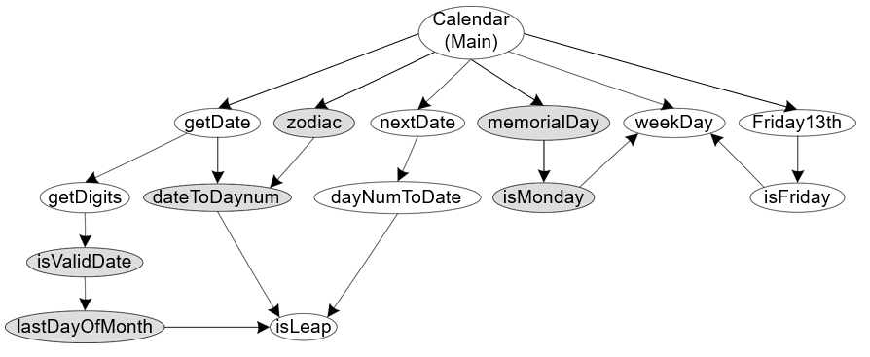
Three Pairs for Pair-Wise Integration

Slide 54
Neighborhood Integration
The neighborhood (or radius 1) of a node in a graph is the set of nodes that are one edge away from the given node.
This can be extended to larger sets by choosing larger values for the radius.
Stub and driver effort is reduced.

Slide 55
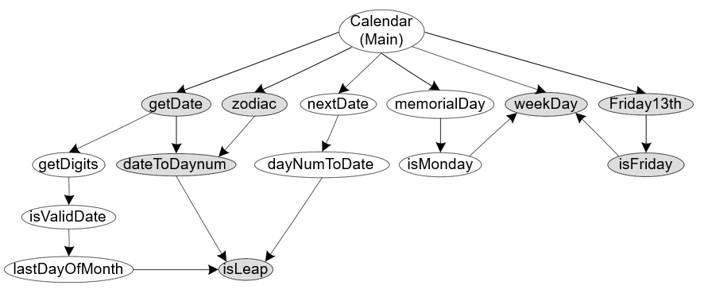
Two Neighborhoods (radius = 1)

Slide 56
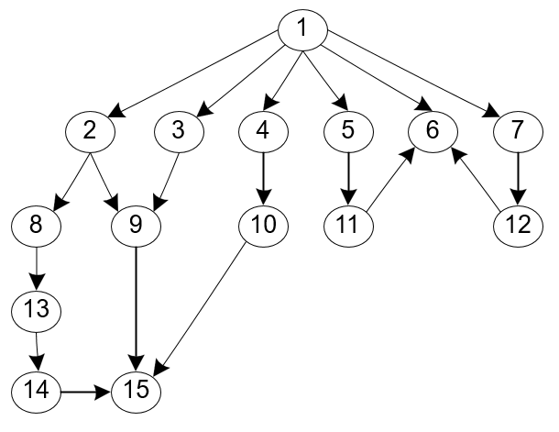
Calendar Call Graph with Numbered Nodes

Slide 57
Neighborhoods in the Calendar Program Call Graph
Node | Unit name | Predecessors | Successors
1 | Calendar (Main) | (none) | 2, 3, 4, 5, 6, 7
2 | getDate | 1 | 8, 9
3 | zodiac | 1 | 9
4 | nextDate | 1 | 10
5 | memorialDay | 1 | 11
6 | weekday | 1, 11, 12 | (none)
7 | Friday13th | 1 | 12
8 | getDigits | 2 | 13
9 | dateToDayNum | 3 | 15
10 | dayNumToDate | 4 | 15
11 | isMonday | 5 | 6
12 | isFriday | 7 | 6
13 | isValidDate | 8 | 14
14 | lastDayOfMonth | 13 | 15
15 | isLeap | 9, 10, 14 | (none)

Slide 58
Comparison of Integration Testing Strategies
Strategy Basis | Ability to test interfaces | Ability to test co-functionality | Fault isolation and resolution
Functional Decomposition | acceptable, but can be deceptive (phantom edges) | limited to pairs of units | good to a faulty unit
Call Graph | acceptable | limited to pairs of units | good to a faulty unit

Slide 59
Continuous Testing
Continuous Integration is a software development practice where members of a team integrate their work frequently, usually each person integrates at least daily - leading to multiple integrations per day.
Each integration is verified by an automated build (including test) to detect integration errors as quickly as possible.

Slide 60
Continuous Testing
Continuous build:
Build from day one
Test from day one
Integrate from day one
System is always runnable
Requires integrated tool support:
Continuous build server
Automated tests with high coverage
Tool supported refactoring
Software configuration management
Issue tracking

Slide 61
Continuous Testing Strategy
A
Spread SheetView
Layer I
B
C
D
Data Model
Calculator
Currency
Converter
Layer II
E
F
G
BinaryFile Storage
XMLFile Storage
Currency DataBase
Layer III
+ Cells
+ Addition
Sheet View
+ File Storage
Notes:
SCRUM
Scheibe vom Brot XXXX

Slide 62
Which Integration Strategy should you use?
Factors to consider
Location of critical parts in the system
Availability of hardware
Availability of components
Scheduling concerns

Slide 63
Which Integration Strategy should you use?
Bottom up approach
Good for object oriented design methodologies
Test driver interfaces must match component interfaces
Top-level components are usually important and cannot be neglected up to the end of testing
Detection of design errors postponed until end of testing
Top down approach
Test cases can be defined in terms of functions examined
Need to maintain correctness of test stubs
Writing stubs can be difficult

Slide 64
Steps in Integration Testing
1. Based on the integration strategy, select a component to be tested. Unit test all the classes in the component.
2. Put selected component together; do any preliminary fix-up necessary to make the integration test operational (drivers, stubs)
3. Test functional requirements: Define test cases that exercise all use cases with the selected component
4. Test subsystem decomposition: Define test cases that exercise all dependencies
5. Test non-functional requirements: Execute performance tests
6. Keep records of the test cases and testing activities.
7. Repeat steps 1 to 7 until the full system is tested.
The primary goal of integration testing is to identify failures with the (current) component configuration.

Slide 65
Summary
Integration testing focuses on interactions
Must be built on foundation of thorough unit testing
Integration faults often traceable to incomplete or misunderstood interface specifications
Prefer prevention to detection, and make detection easier by imposing design constraints
Strategies tied to project build order
Order construction, integration, and testing to reduce cost or risk
Notes:
65

